Slide 1

FUTURE SALES PRDICTION:

Slide 2
INTRODUCTRION:
Data science is a dynamic and continually evolving field, and its applications are ubiquitous in our modern world, influencing decision-making processes in sectors like finance, healthcare, marketing, and more. As organizations continue to collect and generate vast amounts of data, the role of data science in extracting valuable insights and driving innovation remains a critical component of the global technological landscape.

Slide 3
Future sales prediction
Future sales prediction, also known as sales forecasting, is the process of using historical sales data, along with other relevant information and predictive techniques, to estimate or predict the future sales performance of a product, service, or business. The goal is to make informed decisions about production, inventory, marketing, and resource allocation based on these forecasts.

Slide 4
Dataset source
The dataset for the above mentioned project was obtained from kaggle website.
Kaggle is an popular dataset providing source,where obtained datasets are with high quality and less errors.

Slide 5
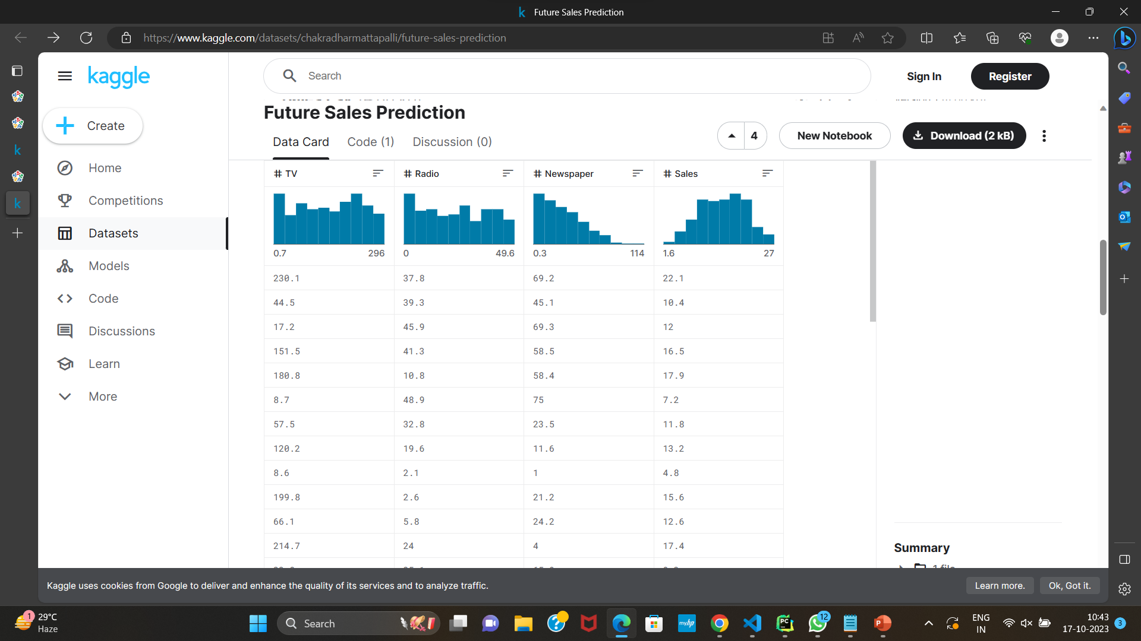
GIVEN DATASET:

Slide 6
Training and Testing Data: To evaluate a machine learning model, you typically divide your dataset into two parts: a training set and a testing set. Cross-Validation: Cross-validation is a technique to assess a model's performance by splitting the data into multiple subsets or "folds."
Confusion Matrix: A confusion matrix is commonly used for binary classification problems.
Accuracy: Accuracy is a simple metric that measures the proportion of correct predictions out of all predictions made.
Precision: Precision is the ratio of true positives to the total number of positive predictions.
Recall (Sensitivity or True Positive Rate): Recall is the ratio of true positives to the total number of actual positives

Slide 7
FEATURE ENGINEERING:
Feature engineering is a critical aspect of data science and machine learning that involves creating new features or modifying existing ones in your dataset to improve the performance of a predictive model. Good feature engineering can lead to more accurate and efficient machine learning models. Here are some key aspects and techniques of feature engineering:

Slide 8
TYPES OF FEATURE ENGINEERING:
Feature Extraction
Feature Transformation
One-Hot Encoding
Feature Scaling
Feature Selection
Handling Missing Values
Creating Interaction Features
Time-Based Features:
Text and NLP Feature Engineering
Domain-Specific Features

Slide 9
IMPORTING PACKAGE FOR THE FEATURE ENGINEERING:
import pandas as pd
from sklearn.model_selection import train_test_split
from prophet import Prophet
from prophet.diagnostics import cross_validation
from prophet.diagnostics import performance_metrics
from sklearn.metrics import accuracy_score
import matplotlib.pyplot as plt

Slide 10
MODEL TRAINING:
Model training is a crucial step in machine learning and deep learning, where a model learns to make predictions or decisions based on data. During the training process, a machine learning model is exposed to a dataset, and it adjusts its internal parameters to minimize the error or loss function, effectively learning patterns and relationships in the data.

Slide 11
Model Selection:
Choose the appropriate machine learning algorithm or deep learning architecture for your task.
Loss Function:
Define a loss function (also known as a cost function) that quantifies the error between the model's predictions and the actual target values
Model Initialization:
Initialize the model's parameters.
Training Algorithm:
Utilize optimization algorithms (e.g., gradient descent) to adjust the model's parameters iteratively.

Slide 12
Prophet
The Prophet algorithm, developed by Facebook, is designed to handle time series data with strong seasonal patterns, multiple seasonality, and holiday effects.
It employs an additive model that combines various components, including trend, seasonality, holiday effects, and potentially other user-specified components.

Slide 13
In the above dataset there are four main features
TV
Radio
Newspaper
Sales
In,this dataset TV,Radio,Newspaper are independent variables and Sales is dependent variable.Based on the this we have to find the future sales

Slide 14
How to train and test Data
To split your data into training and testing sets, you can use the
train_test_split function from the sklearn.model_selection module. This
function randomly shuffles and partitions your data into two subsets,
typically one for training and one for testing.
Code:
from sklearn.model_selection import train_test_split
# Assuming 'X' is your input data and 'y' is your target variable
X_train, X_test, y_train, y_test = train_test_split(X, y, test_size=0.2, random_state=42)

Slide 15
.Batch Training: Training is often performed in batches of data points rather than a single data point at a time
Hyperparameter Tuning:
Hyperparameters are settings that are not learned by the model during training. These include learning rates, the number of layers in a neural network, and other parameters that affect the ess.
Regularization:
Apply regularization techniques such as L1 or L2 regularization to prevent overfitting, which occurs when the model performs well on the training data but poorly on unseen data.
Monitoring Training Progress:
Track training metrics like loss, accuracy, or validation error to monitor the model's performance during training

Slide 16
EVALUATION:
Evaluation refers to the process of assessing or measuring the quality, effectiveness, or performance of a system, model, process, or any other entity.

Slide 17
MODEL EVALUATION AND METRICS:
Model evaluation and metrics are essential components of the machine learning and data analysis process. They help assess the performance and effectiveness of predictive models, such as classification, regression, clustering, and more. Here are some key concepts and metrics related to model evaluation:

Slide 18
CODE:
import pandas as pd from sklearn.model_selection import train_test_split from prophet import Prophet from prophet.diagnostics import cross_validation from prophet.diagnostics import performance_metrics from sklearn.metrics import accuracy_score import matplotlib.pyplot as plt
pd.set_option("display.max_columns", None) df = pd.read_csv("Sales.csv") q1=df["Newspaper"].quantile(0.25) q3=df["Newspaper"].quantile(0.75) thr=1.5 iqr=q3-q1 lower=q1-thr*iqr upp=q3+thr*iqr mean_value=df["Newspaper"].mean() df["Newspaper"][(df["Newspaper"]<lower) | (df["Newspaper"]> upp)] = mean_value

Slide 19
date_values = pd.date_range(start='2023-10-28', periods=len(df), freq='D') df["dates"] = date_values df = df.rename(columns={"dates":"ds"}) x = df.drop("Sales", axis=1) y = df["Sales"] print(df.head()) plt.boxplot(df["TV"]) plt.show() plt.boxplot(df["Radio"]) plt.show() plt.boxplot(df["Newspaper"]) plt.show() x_values = list(range(1, len(df["TV"])+1)) plt.scatter(x_values, df["TV"], label="datapoints", color="blue") # there are no categorical values so need of onehot encoder X_train, X_test, y_train, y_test = train_test_split(x, y, test_size=0.15, random_state=3) train_data = pd.DataFrame({"ds":X_train["ds"],"y":y_train,'TV': X_train['TV'], 'Radio': X_train['Radio'], 'Newspaper': X_train['Newspaper']})

Slide 20
# Step 1: Load your dataset with dates, sales, and additional features # Step 2: Data preprocessing data = df.rename(columns={'Date': 'ds', 'Sales': 'y', 'TV': 'TV', 'Radio': 'Radio', 'Newspaper': 'Newspaper'}) # Step 3: Initialize Prophet model with additional regressors model = Prophet() model.add_regressor('TV') model.add_regressor('Radio') model.add_regressor('Newspaper') # Step 4: Fit the model with the entire dataset model.fit(train_data) # Step 5: Create a dataframe for future dates and features for prediction future = model.make_future_dataframe(periods=len(X_test)) # Add feature data for the test set future['TV'] = 180.8 future['Radio'] = 10.8 future['Newspaper'] = 58.4
\

Slide 21
forecast = model.predict(future) # Step 7: Visualize the predictions fig = model.plot(forecast) plt.show() specific_date = pd.to_datetime("2023-11-01") prediction = forecast.loc[forecast["ds"] == specific_date]['yhat'].values[0] print(prediction) components = model.plot_components(forecast) #result result = cross_validation(model, horizon="1 days", period="30 days", initial="90 days") metrics = performance_metrics(result) print(metrics)

Slide 22
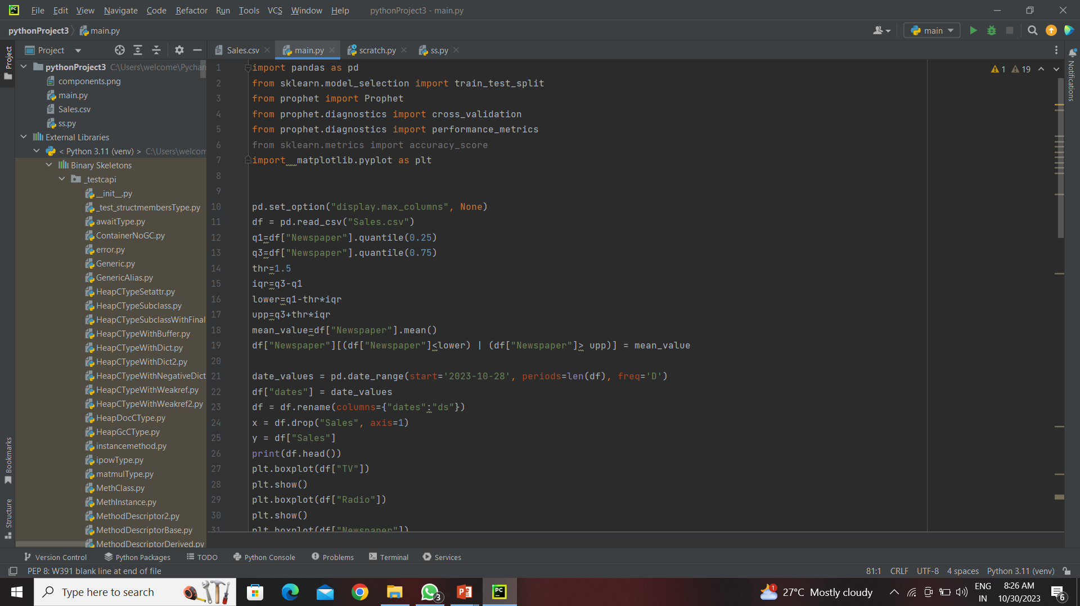

Slide 23
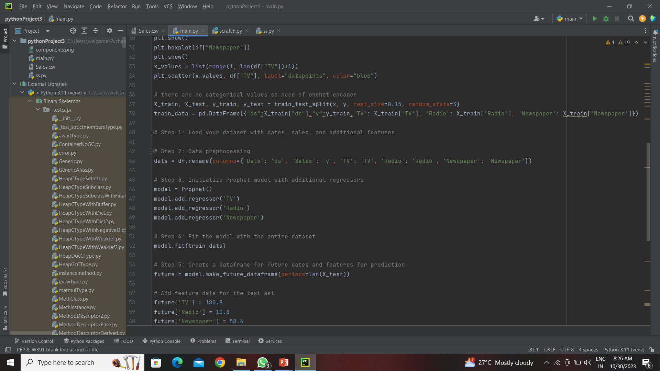

Slide 24
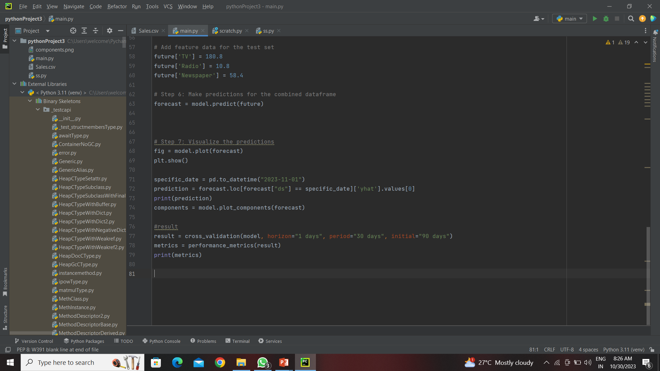

Slide 25
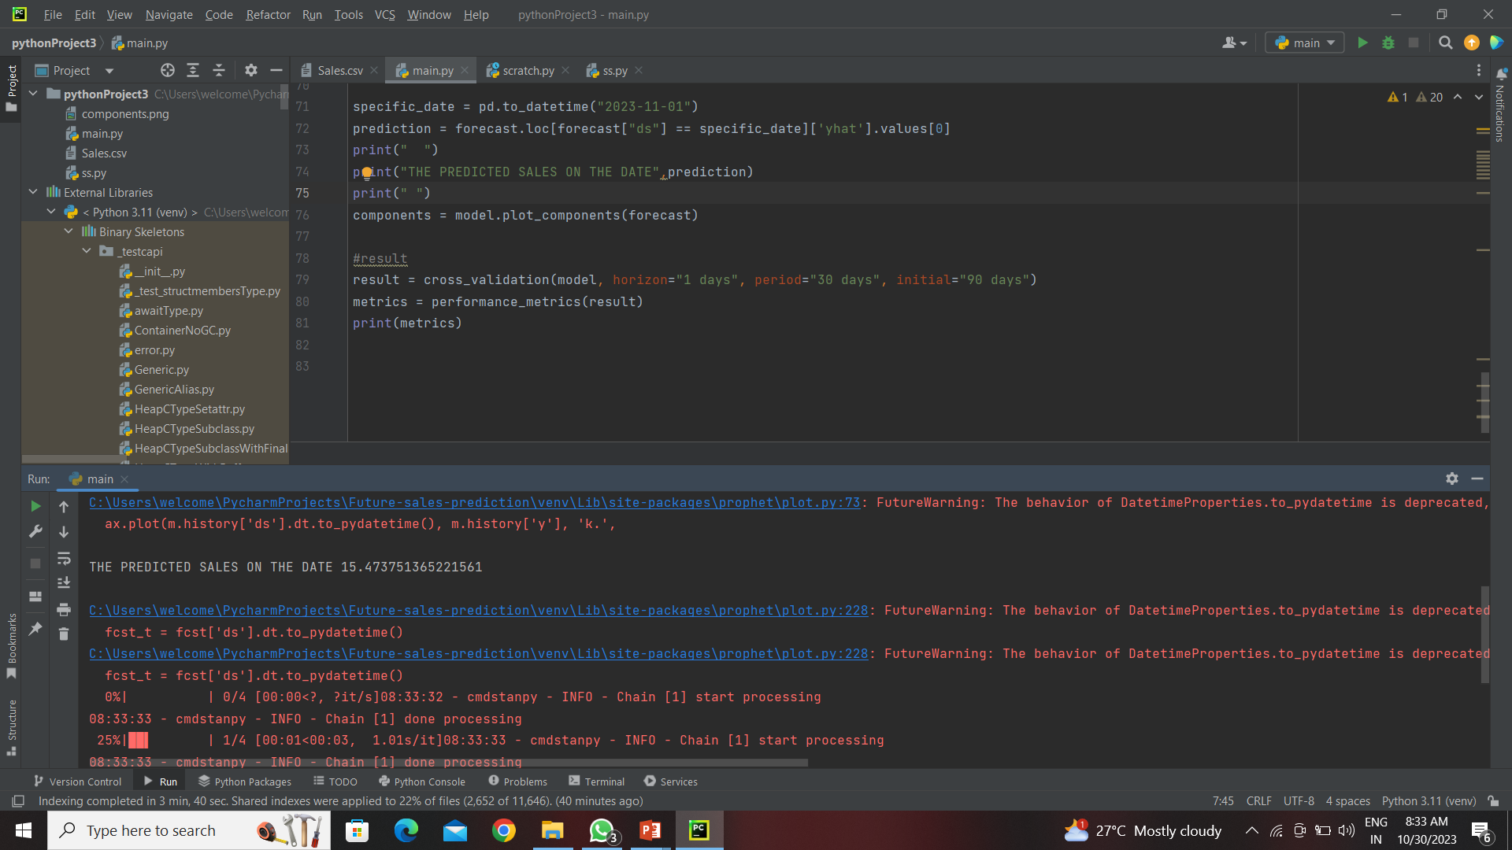

Slide 26
CONCLUSION:
In this sales prediction analysis, we employed advanced data modeling techniques and historical sales data to make informed projections about future sales. Several important insights and findings emerged from the analysis

